Slide 1
Tip of the Week: Recommendations on LinkedIn Gordon Claus
Goals:
Be able to write recommendation(s) for your connections, and
Request recommendation(s) from your connections
Why? Many employers will look to LinkedIn as a tool to screen out job candidates – so, if a prospective employer looks you up on LinkedIn your recommendations are available for them to review.
Notes:
Suggest you discuss the recommendation before hand

Slide 2
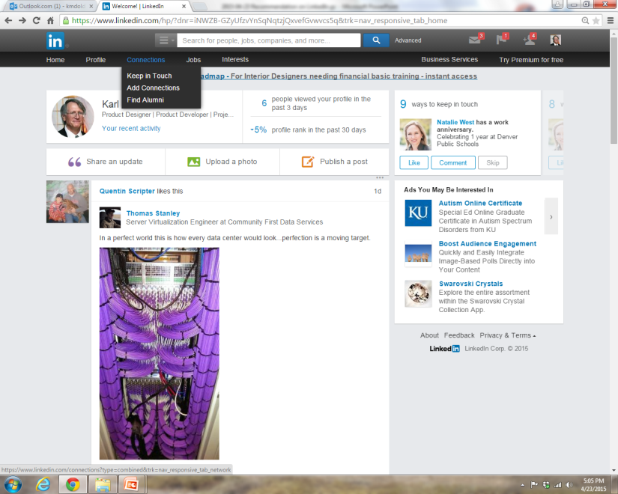
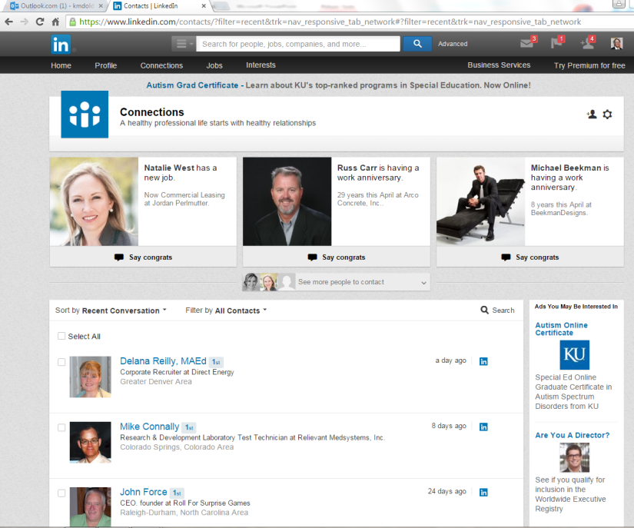
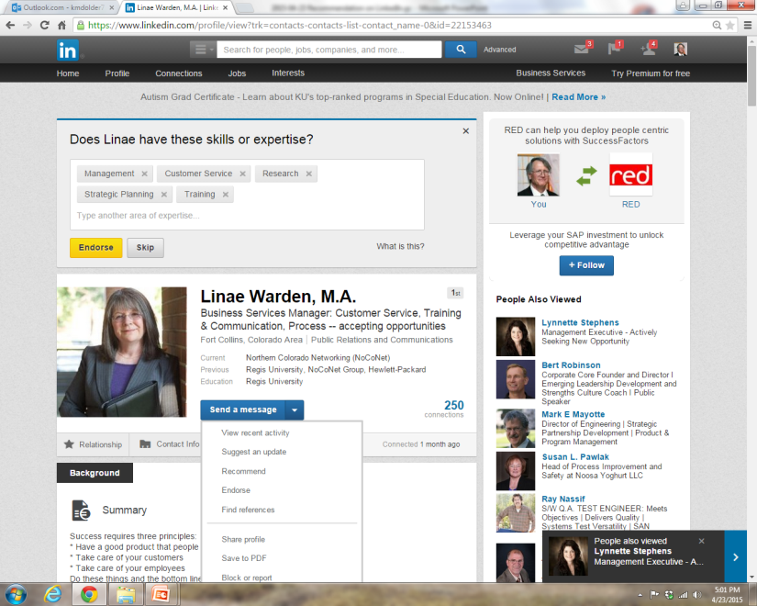
How To Provide a Recommendation
From your LinkedIn home page
Click “Connections”
Scroll down to the profile of the person for whom you want to write an recommendation
Click on the “Send a Message” dropdown menu and select “Recommend”
3
Notes:
To Provide a Recommendation for a Contact:
Go to your Connection Profile which you are to provide a Recommendation for.
Click the “Send a Message “ down arrow – Click on “Recommend”

Slide 3
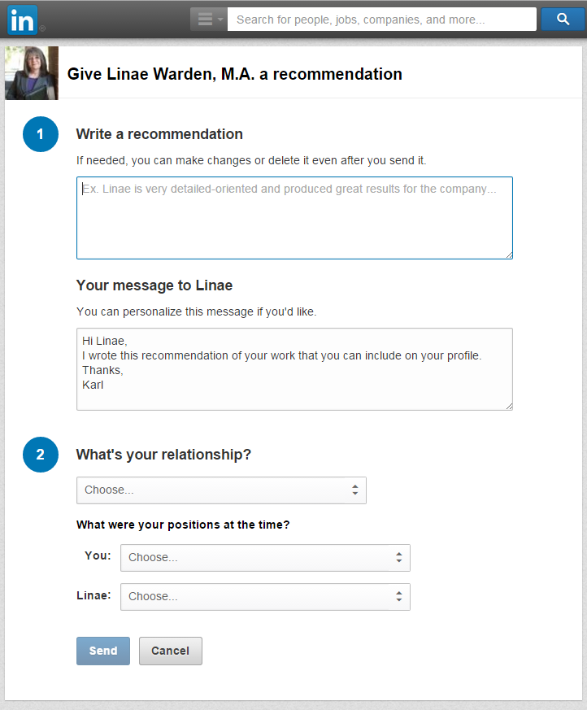
Write a brief recommendation;
Use the STARS format as a guide – Situation
Task
Action
Results
So What
Fill out a personalized message to the person for whom you wrote the Recommendation
Select the professional relationship references you have with the person from the drop down menus

Slide 4
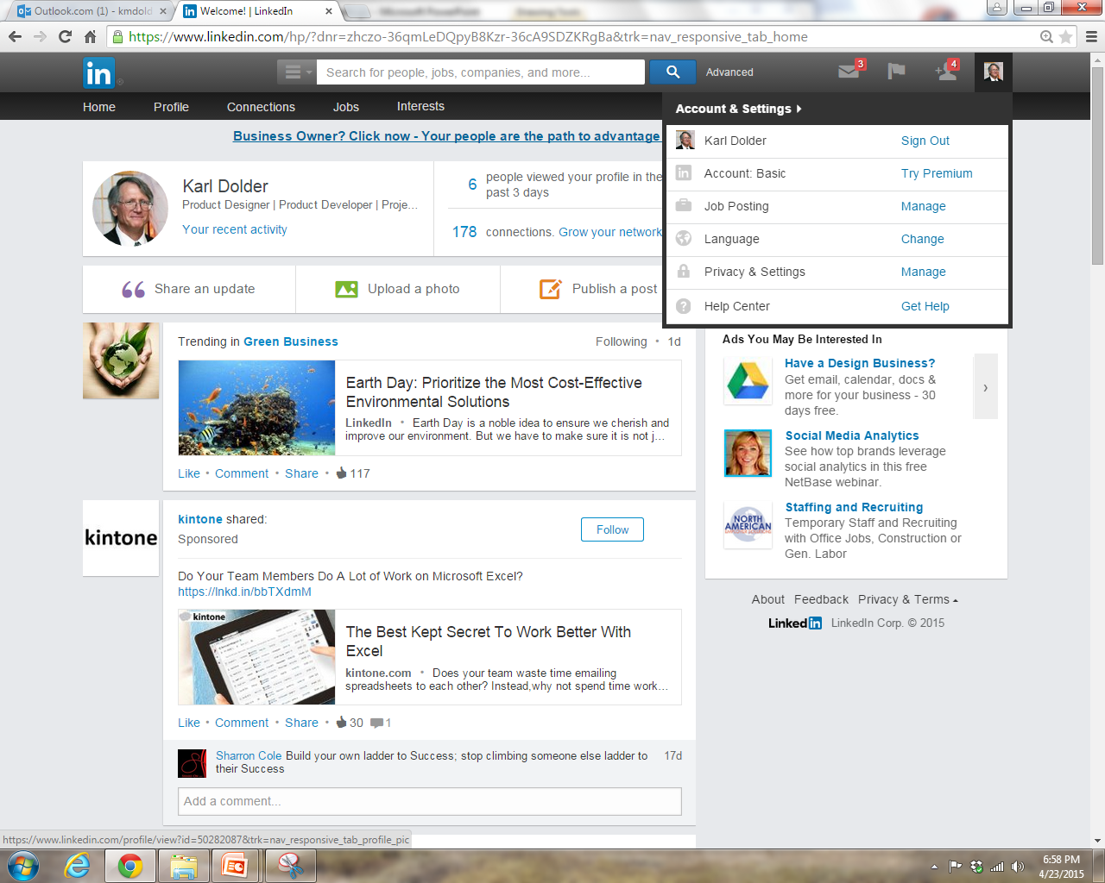
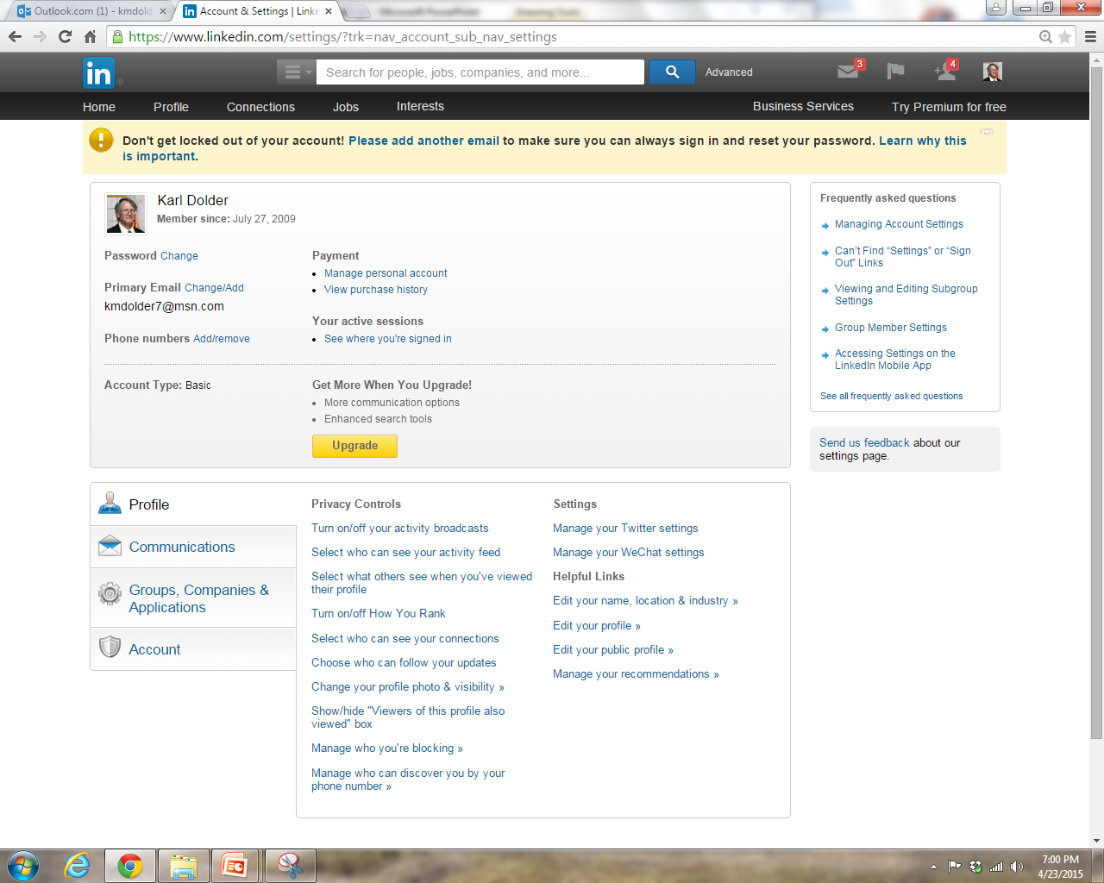
How Ask for a Recommendation
From your LinkedIn home page:
Click on your image in the upper right hand corner
On the Privacy and Settings menu Item Click Manage
Click on
Manage your Recommendations
Notes:
From your profile, click on “Ask for recommendations”
Fill out the request for recommendation message and click “Send”
You may wish to give them pointer on what you want them to say

Slide 5
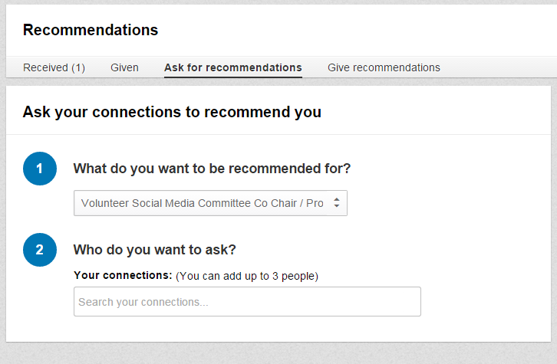
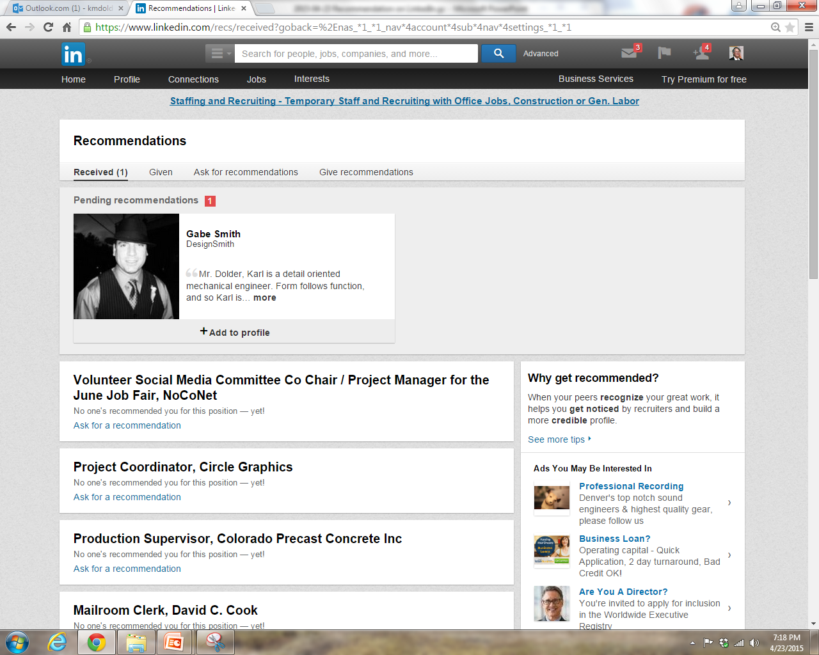

Slide 6
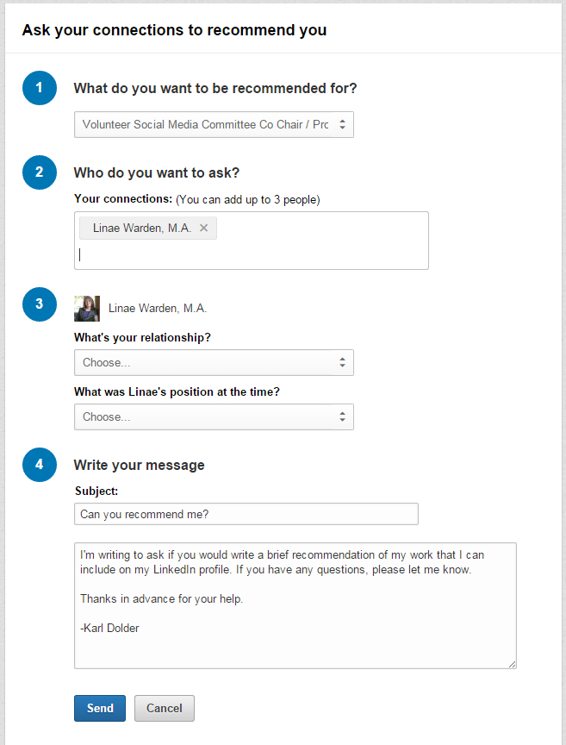
When you type in a connection’s name in box 2, boxes 3 and 4 appear with drop down selections based on the information in the profiles. Make selections as appropriate.
Personalize the message in box 4
Click “Send”

Slide 7
What Are The Next Steps?
Once you receive a recommendation:
Review the recommendation (LinkedIn does not have spell-check!)
Ask for updates or accept the recommendation
Choose to post the recommendation
Thank the person who wrote the recommendation
How many recommendations per job description should you have?
2 per position

Slide 8
More Info
Handout on Back Table
How to join LinkedIn
How to add NoCoNet group
Informal Personalized LinkedIn Help Session Tuesdays @ 9:30 am to 10:30 am
@ Wild Boar Coffee Shop in the basement
If you have a laptop or tablet, please bring it
Social Media Committee business meeting : 8:30 to 9:30

Slide 9
http://www.youtube.com/user/noconet
Introduction to LinkedIn groups.
How To – Join a LinkedIn Group
How To - Post a Discussion on a LinkedIn Group
How To – Send a Message to a Group Member
How To – Create Custom URL for LinkedIn

