Slide 1
Networking: Health Options for the Unemployed

Slide 2
Larimer Health Connect
Helping local residents get connected to coverage
Julie Wenzel, Certified Health Coverage Outreach Specialist

Slide 3
What are the options?
Child Health Plan Plus
Health First Colorado (Medicaid)
Tax Credits & Subsidies

Slide 4
What’s covered?

Slide 5
Income Eligibility

Slide 6
Health First Colorado (Medicaid) & CHP+ Eligibility
To be eligible for Health First Colorado or CHP+, you must:
Be a U.S. citizen; or lawfully residing immigrant for 5 years
Be a Colorado resident
Meet income guidelines
Not be incarcerated; (Can apply if on probation or parole)
Note: CHP+ is limited to children up to 18 years old & pregnant women and has different income guidelines

Slide 7
Health First Colorado (Medicaid) & CHP+ Cost Examples
Health First Colorado (Medicaid) coverage
No monthly premium
No deductible
Prescription co-pays $0-$5
CHP+ Coverage
Annual enrollment fee
$25 to $105 based on income and number of children
Prescription co-pays are $0-$10

Slide 8
Connect for Health Colorado

Slide 9
When can you sign up?
Year Round
Special Enrollment Period
Health First Colorado (Medicaid) & CHP+ Enrollment
Open Enrollment
Special Enrollment period for Qualified Life Changes
Open Enrollment
Nov. 1st – Jan. 31st

Slide 10
Where can I go for help?
Colorado PEAK
Online Chat: colorado.gov/PEAK
Helpline: 1-800-359-1991
Connect for Health Colorado
Online Chat: connectforhealth.com
State Phone Helpline: 1-855-PLANS4YOU (855-752-6749)
In-Person Help: Larimer County
Larimer Health Connect - Trained Health Coverage Specialists
Other Health Coverage Guides
Certified Application Counselors
Certified Agents and Brokers

Slide 11
Larimer Health Connect
Free, unbiased, in-person assistance here in Fort Collins and Loveland!
We can help you understand
The Health Care Law
Your options for health insurance
How to make a decision about health insurance
The application process
“Could I have done this on my own? No!
I don’t have a clue about insurance.”
- Caitlin
Bilingual help, too!

Slide 12
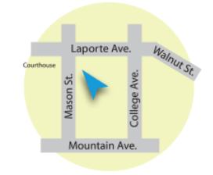
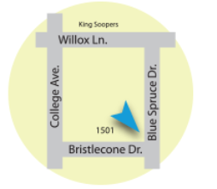
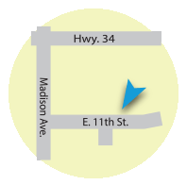
Where can you go for help?
3 Sites in Larimer County
Health District of Northern Larimer County
Old Town Fort Collins
Loveland:
Community Life Center

Slide 13
What to bring to an appointment
Social Security card
Driver’s license or identification card
Birth certificate(s)
Address information
Pay stubs
W-2 forms
Information about any other income you get
Information about current health insurance (if you have it)
Information about any job-related insurance you or your family may be able to get, even if you’re not enrolled in it
If applicable, immigration documents that may include:
Reentry permit
Permanent resident card
Employment authorization card
Unexpired foreign passport
Immigrant visa
Certificate of eligibility

Slide 14
(970) 472-0444
www.larimerhealthconnect.org

